Slide 1

Hardware-Efficient Ansatz Design
and Noise-Aware
Analysis of a Variational Quantum Classifier
for IQM Spark
Axion
Science Club
2026 IEEE International Conference on Quantum Control, Computing and Learning
Aalborg, Denmark

Slide 2
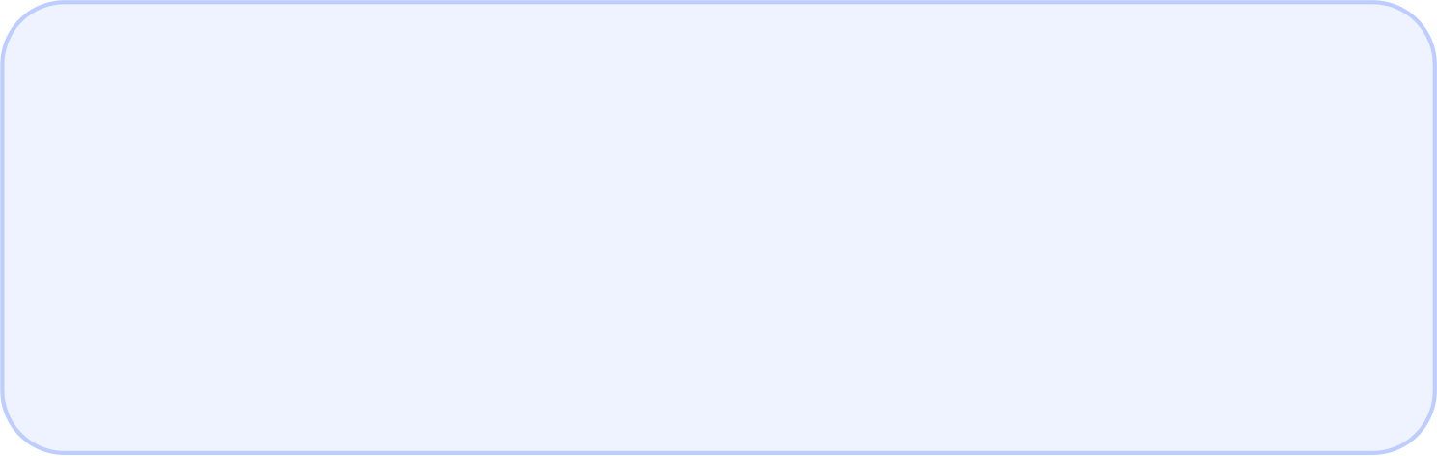
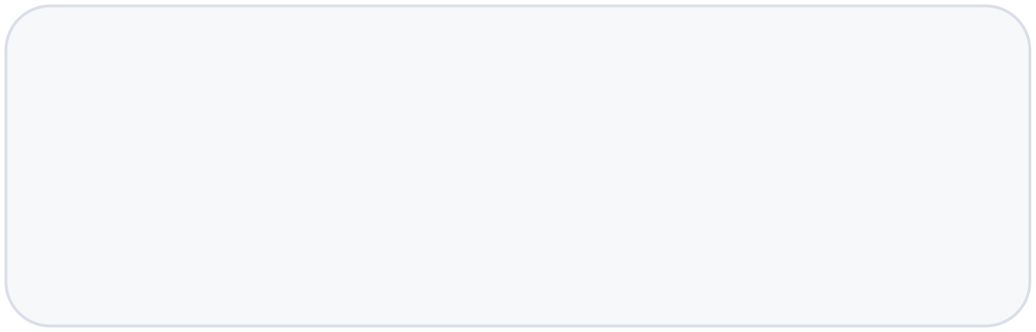
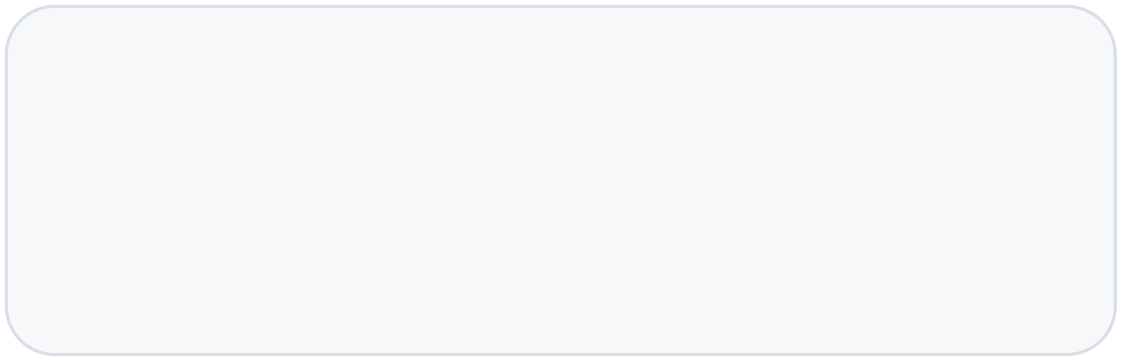
Abstract
Most candidate ansatza rchitectures were simulator-oriented. On ODRA5,that gap became visible: simulator-to-hardware metrics were large and unstable.
RESEARCH GAP
Controlled rotations are convenient in simulation,
but expensive once decomposed to hardware
gates.
CONTRIBUTION
We introduce an ODRA-efficient ansatz using RZ
rotations and CZ entanglers.
CONTROL
Both families keep the same trimmed 5-qubit rin
structure and parameter count.

Slide 3
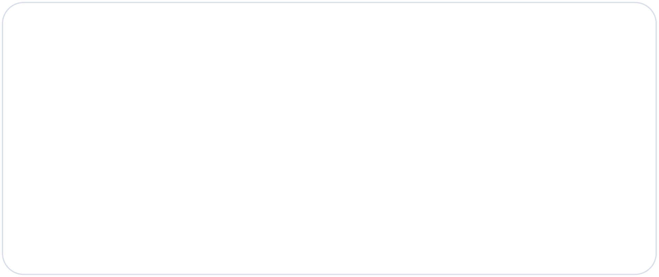

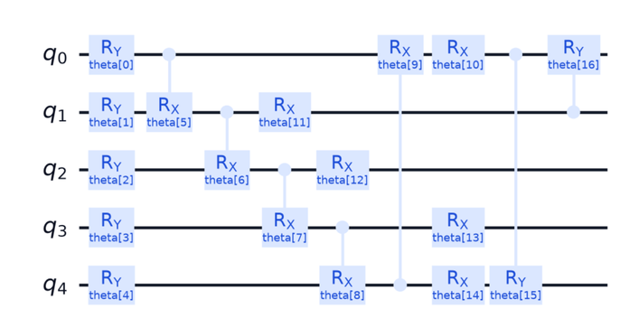

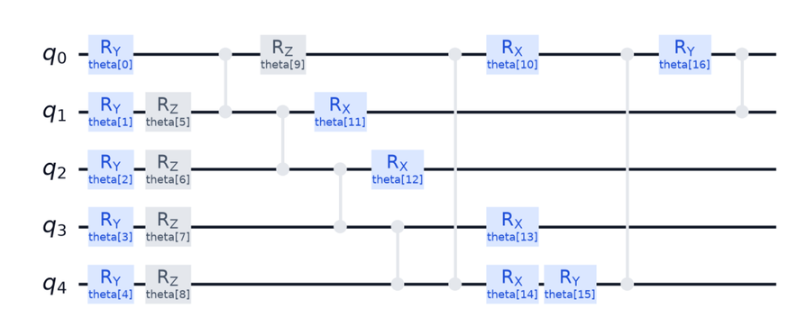

Abstract
ansatz_simulator(5, 2)
CRX / CRY ring · generated from code
ansatz_odra(5, 2)
RZ + CZ native ring · generated from code

Slide 4
Metrics on ODRA
We assess the two ansätze on several axes. This axis runs them on the physical QPU (ODRA 5) and measures accuracy and F1 under real hardware noise.
A single hardware measurement depends on a hardware budget:
shots – repetitions of one circuit per evaluation
repeats – independent re-runs of that evaluation
The budget sets the precision and stability of the measurement.
We do not hardcode it – it must be chosen.

Slide 5
The pilot
A short pilot runs on 2 of the 5 folds. It selects the budget in two ordered steps:
Shots → stability
Repeats → precision
Sweep shot counts
512 → 1024 → 2048 → 4096.
Take the smallest where accuracy and F1 stop changing
(|∆acc| ≤ 0.01, |∆F1| ≤ 0.02)
At that shot count, size the repeats to a 95% confidence interval. Grounded in the law of large numbers and the central limit theorem.
The selected shots and repeats then run on the full 5-fold cross-validation.

Slide 6
Selected budgets
depth
L=2
1024 7
L=4
4096 45
L=6
1024 4
shots repeats
The pilot returns a different budget for each depth.
The budget is measured and selected, not arbitrary.

Slide 7
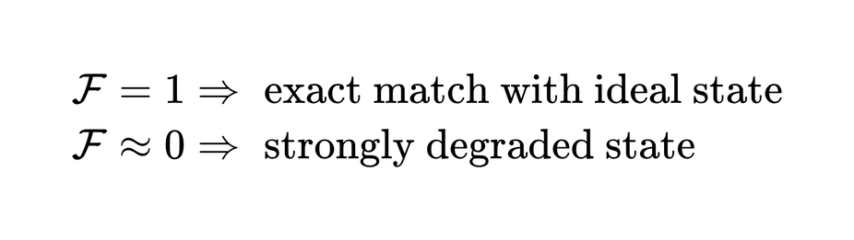
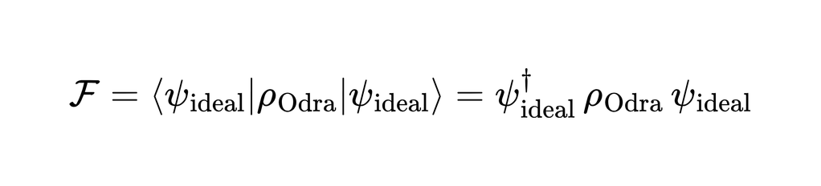
Fidelity
Did IQM SPARK actually prepare the state predicted by a noiseless simulation?
Intuition: take the ideal state vector, “pass” it through the hardware density matrix, and measure the overlap - see how well the hardware preserves the target state.

Slide 8
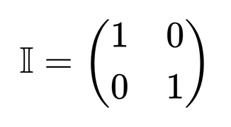
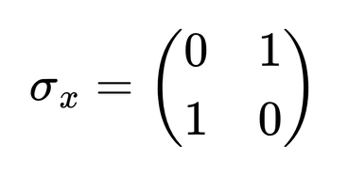
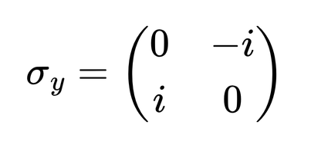
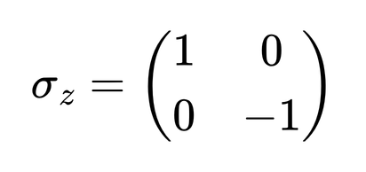
Tomography
We measure in many bases because ρ has many independent parameters. Different Pauli expectations ⟨P⟩ require different measurement bases.

Slide 9
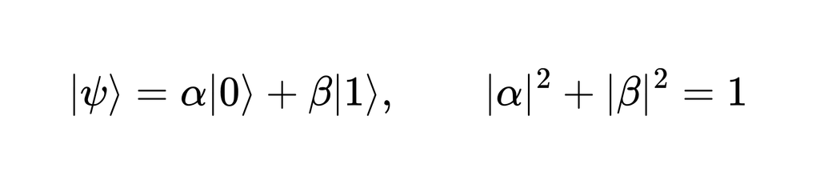
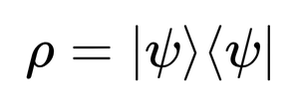
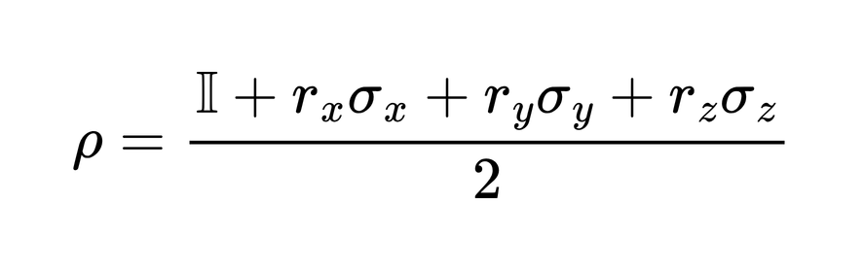
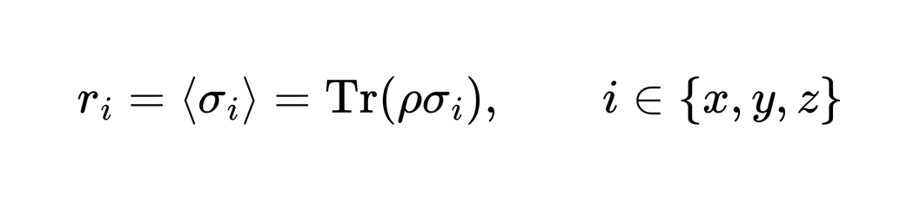
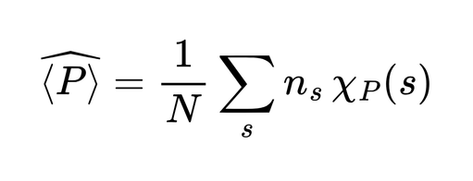
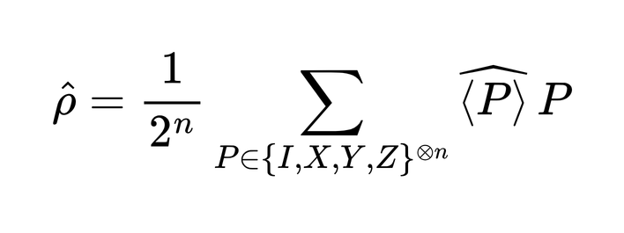
pure state:
density matrix:

Slide 10
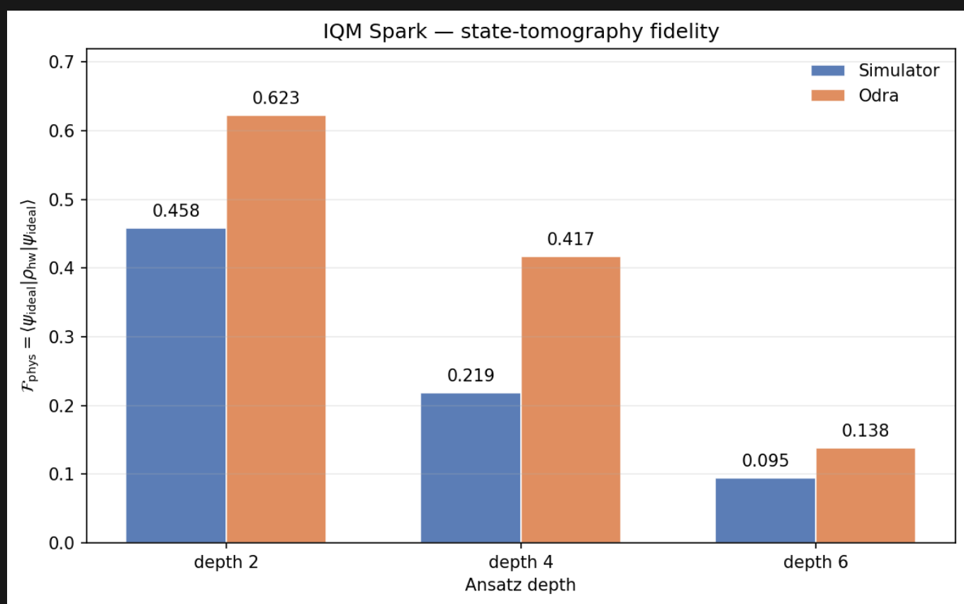
Fidelity results

Slide 11
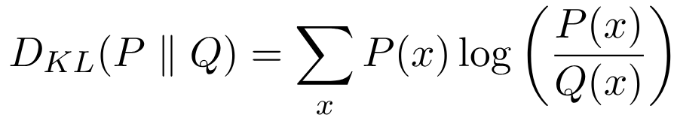
Kullback-Leibler divergence
KL expressibility measures how closely the distribution of random pairwise state overlaps produced by an ansatz matches the overlap distribution expected from uniformly random pure states, with lower values indicating broader, more Haar-like exploration of the state space at the tested depth.

Slide 12

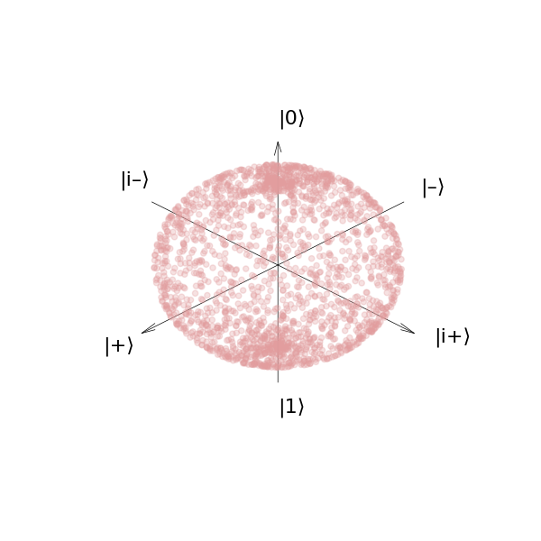
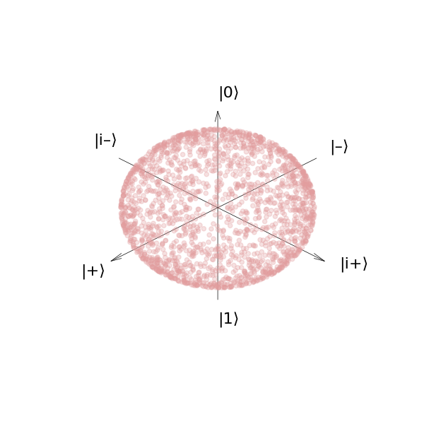
Haar
Random:
Haar:

Slide 13
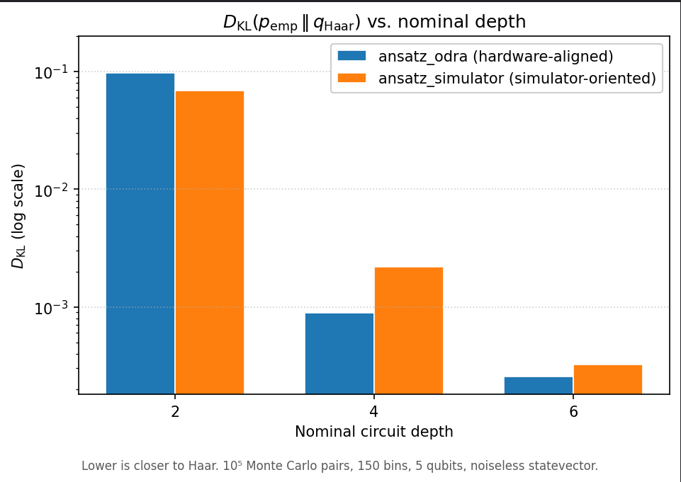
KL divergence results

Slide 14



Meyer-Wallach score
We use Meyer-Wallach as a hardware-feasible global entanglement metric: it only requires one-qubit reduced states, not full state tomography.
REDUCED STATE OF QUBIT I
LOCAL MARGINALS
Trace out the rest of the system and keep the one-qubit reduced state for each qubit.
MEYER-WALLACH SCORE
THREE BASES
Estimate local Pauli expectations from Z directly, X after H, and Y after S† then H.
BLOCH-VECTOR ESTIMATOR
AVERAGE OVER PARAMETERS
For each ansatz and depth, compute the mean MW score across random parameter samples.

Slide 15
Meyer-Wallach results
The difference must be judged against the uncertainty of the difference, not only against the individual mean estimates.
Depth 2
0.682 vs 0.688
ODRA vs simulator · d = -0.006 · h95(d) ≈ 0.040
Not distinguishable: the observed gap is smaller than the uncertainty of the difference.
Depth 6
0.976 vs 0.969
ODRA vs simulator · d = +0.0070 · h95(d) = 0.0039
Resolvable at sample level: ODRA is slightly higher in the recorded single-run example.
TREND
Entanglement increases with depth: roughly 0.68 at depth 2 and 0.97 at depth 6.
COMPARISON RULE
Compare d against h95(d), not just the individual means.
CAUTION
The depth-6 effect is small and should be reported with drift uncertainty.

Slide 16


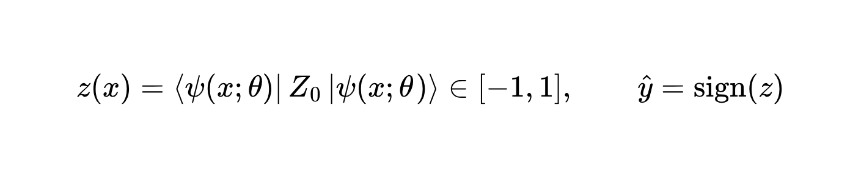

Does it survive real hardware?
Every decision is one number, sign of ⟨Z₀⟩, known exactly in simulation. Expressibility isn’t accuracy — what does hardware noise do to the trained classifier’s decisions?

Slide 17
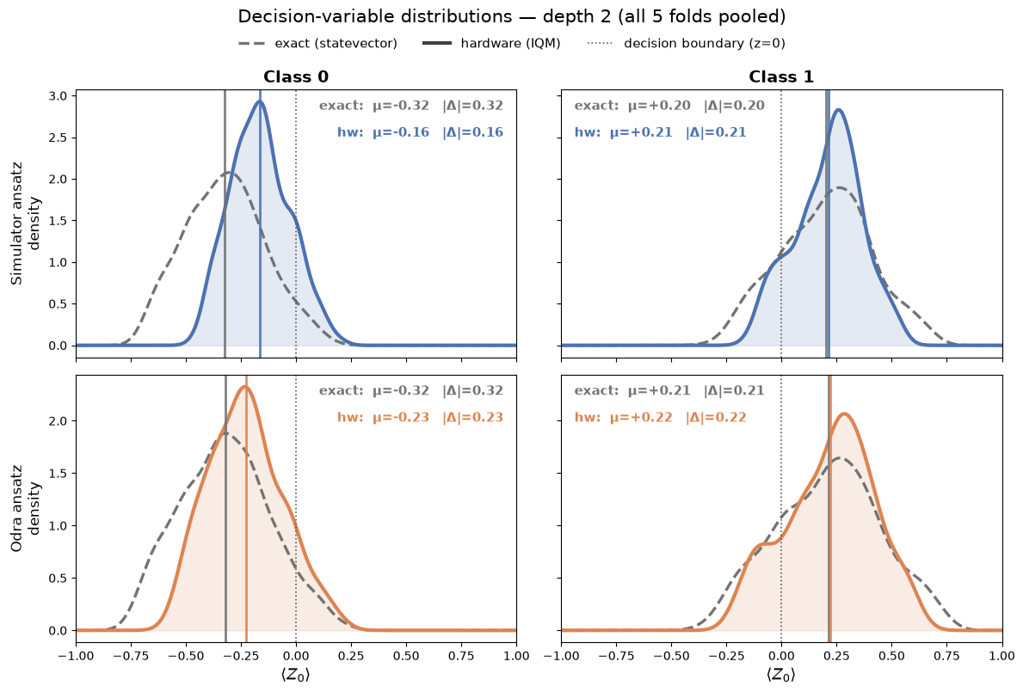
What hardware does to the scores
Hardware contracts every score toward the boundary (λ < 1). A single constant offset b then acts asymmetrically — it trims one class's margin and pads the other's.

Slide 18
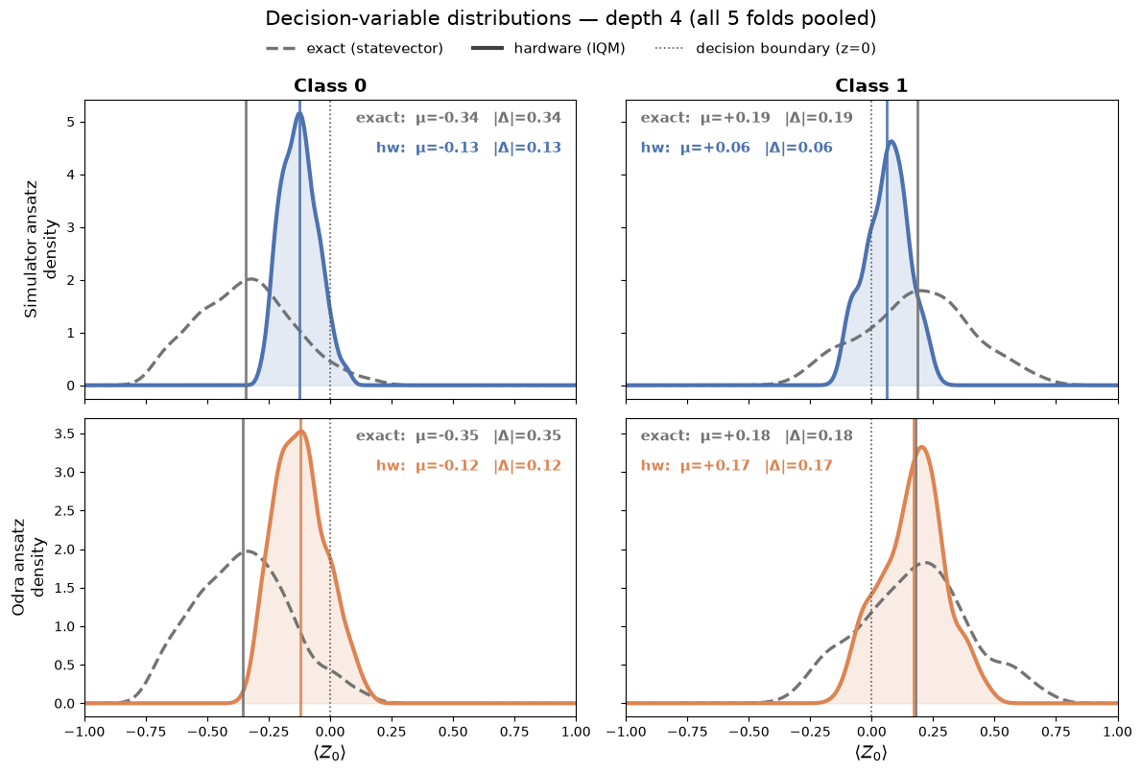
What hardware does to the scores
Hardware contracts every score toward the boundary (λ < 1). A single constant offset b then acts asymmetrically.

Slide 19
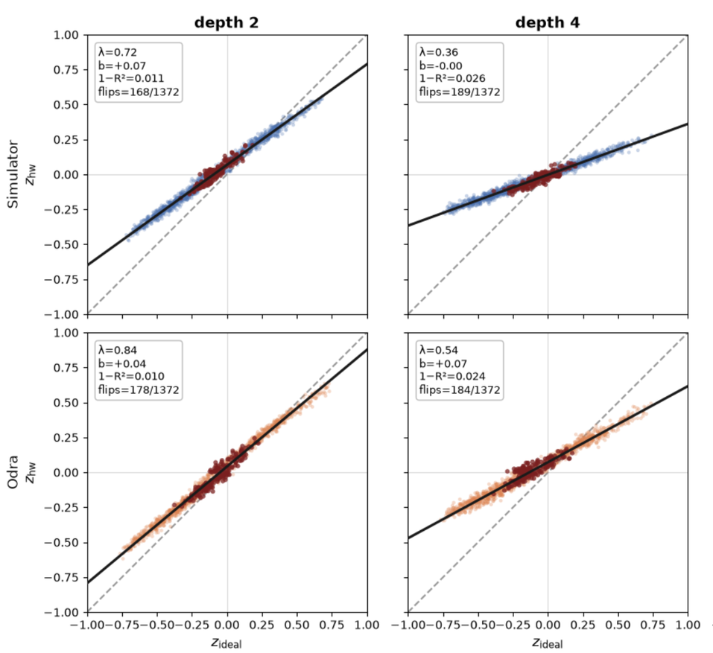
A contraction and a shift
z_hw ≈ λ·z_ideal + b
λ = contraction (slope), b = offset (intercept), R² = how affine the noise is.
red = misclassified (sign-flipped) samples

